Slide 2
Puppetizing your Organization
Rob Nelson
Systems Administrator
@rnelson0
http://rnelson0.com
https://github.com/puppetinabox
Notes:
Today we are going to talk about Puppetizing your Organization. Setting up a proof of concept puppet system is the easy part, but what’s next?

Slide 3

Puppet Ecosystem
Testing
Code Reviews
Best Practices/Patterns
Reporting/
Monitoring
Packaging
Continuous Integration
and Deployment
Bare Metal
Code/Data Separation

Slide 4
Notes:
Let's build something amazing!

Slide 5
Culture

Slide 6
Culture
Be a change agent
Rome wasn’t built in a day
Lots of learning and failure
Communication is key
Pace yourself, avoid culture shock

Slide 7
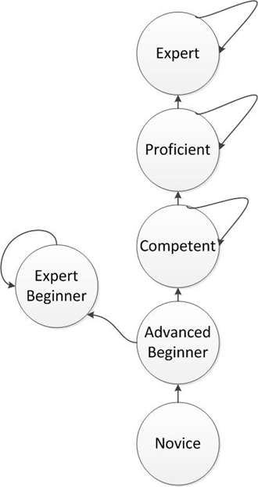
“Expert Beginners”
“I know that I’m doing it right because, as an expert, I’m pretty much doing everything right by definition.” - Erik Dietrich
Don’t let yourself believe you’re a rock star. Avoid working in isolation, without feedback loops.
Notes:
Avoid the "Expert Beginners" trap. Be on the lookout not just for yourself, but for everyone in your organization and company!

Slide 8
Sharing is Caring
Find feedback loops
Puppet User Group (or LUG/VMUG/etc)
Meetup.com (DevOps, Puppet, Conf. Management)
Puppet Labs Test Pilots
Websites: ask.puppetlabs.com, stackoverflow
IRC: #puppet, #puppet-community
Podcasts, Slideshares, Blog Posts, Video Tutorials
Industry Peers (Friends, Co-Workers, Social Media)
Jumpstart Engagement (PL Professional Services)
Get buy-in from your family and your employer. Get permission for the time and don’t share proprietary data!
Notes:
Even if you aren't sharing your company's data, let your manager know anyway. It's better they hear it from you and not second hand.

Slide 9
Code Review
It’s a cultural issue, not a technological issue
Git - Distributed VCS
Mandatory code reviews via Pull Requests (PRs)
Small, discrete, self-contained changes
Enable approvals
ESPECIALLY in emergencies!
Git hooks save time and embarrassment
Be positive!
Notes:
Code reviews are now (semi-)public and tracked. Remember, we're not just looking for problems, we're looking for ways to make things better. Suggest some additions rather than just pointing out the flaws! And if the code is great, let the author(s) know!

Slide 10
Minimum Viable Customization (MVC)
What’s the minimum customization you require to be productive?
Shell prompt shows git branch
Dot files
Git hooks
Puppet module skeleton
Install tools like GitHub / SourceTree / Gepetto, plus minimal tweaks
Integration: Kanban, Ticketing, etc.
Help your co-workers out:
Document a decent baseline setup
Provide vagrant boxes/VMs with everything installed and configured
Use Puppet to maintain these standards
Notes:
Make sure people can be productive on day one – with Puppet/Ruby and any other languages that are commonly used!

Slide 11
Create a culture that works for your team
Notes:
You (probably) don't work with me, so my suggestions are just that. Find what works for your team, your organization, your company, and your industry.

Slide 12
Best Practices and Patterns
Declarative State Model - ‘What’ not ‘How’
Code: Describe desired state through resources in a manifest
Master: Catalog is a graph of all resources to apply to a node
Agent: Applies the catalog, converges state
Avoid exec resources; they are unpredictable and break noop mode
Notes:
Declarative states are NOT shell scripts 2.0. Avoid execs as much as possible. Over reliance on execs is like buying a car, ripping out the floor, and yelling yaba daba doo! Not cool.

Slide 13
Component modules
Shareable modules to install and/or manage a specific component
Apache, TomCat, YourWebApp, Puppet Agent, etc.
Check the forge before writing your own
Puppet Labs has plenty of best practices guides for component modules
Notes:
There are nearly 3,600 forge modules. Always check there. If one does not work out of the box, seriously consider whether you should commit PRs or ask the author for a new feature before writing your own competing module.
If you do write your own, always write it as if it will go on the forge – even if you know it never will – to enforce proper code/data segregation (discussed later).

Slide 14
params/config/install/service pattern
Don’t repeat yourself
Params shared between module subclasses
Put all conditionals together
No one size fits all, only use the subclasses you need
Writing better Puppet modules
Reference module: puppetlabs/ntp
Notes:
Don't repeat yourself.
Don't repeat yourself.

Slide 15
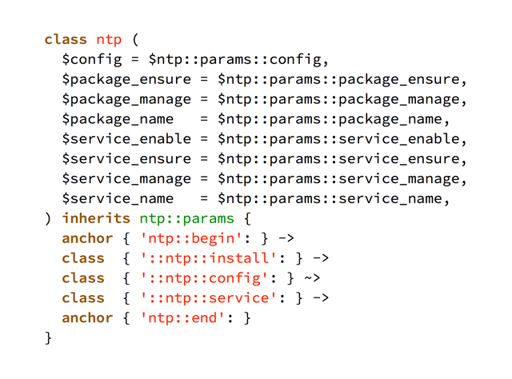
NTP Main Class
Notes:
The 'inherits' keyword causes Puppet to parse the class whose name follows, then bring the results into the current scope.

Slide 16
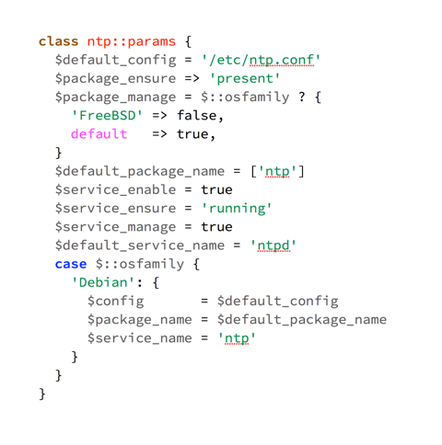
NTP Params Subclass
Notes:
Sane and opinionated defaults.

Slide 17
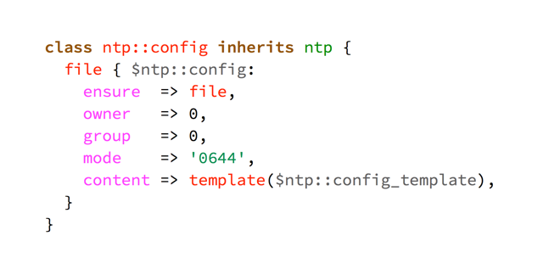
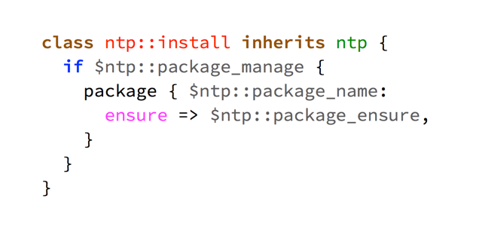
NTP Config and Install Subclasses

Slide 18
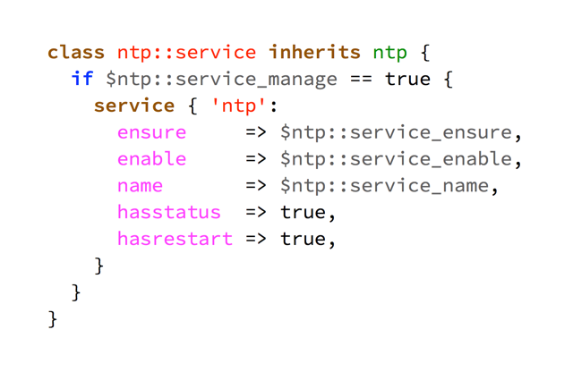
NTP Service Subclass
Notes:
Take a look at the “service_manage” parameter. *I* might want puppet to manage ntp but someone else might not! This lets the user pick which they prefer, with a default of managed. Be opinionated, but let users have their own opinions!

Slide 19
Roles and Profiles
One node, one role - nothing more
Role: Business Logic
Aggregate of profiles. role::webapp includes profiles base, apache, tomcat, webapp
Includes only profile classes and resource ordering
Profile: Technology stack
mysql, puppetdb, base
Contains any type of resource
Notes:
Roles and Profiles is where we build our implementation and reference the component modules.

Slide 20
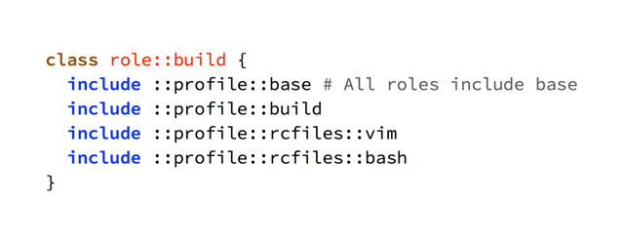
Roles: Profiles Only

Slide 21
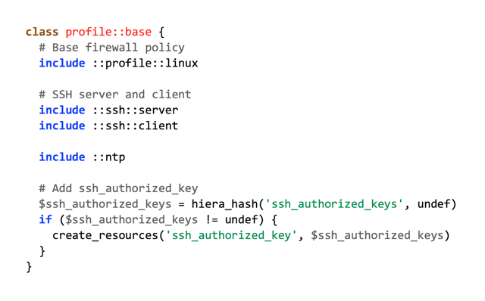
Profiles: Any Resources
Notes:
You can use any resource – but if your profile class starts approaching 100 lines, maybe you should be creating a component module instead. It's a fuzzy line, but you'll know when you've crossed it.

Slide 22
Testing: TDD or BDD
rspec-puppet, puppet-spec, beaker, beaker-rspec
Catch errors early, before production
Unit and Acceptance tests
Write tests before code
Unit tests are a requirement for refactoring
Encourage planning during growth
Missing tests? Add them with puppet-retrospec
Improve tests over time
Notes:
Turn the non-existent user specification into rspec tests! Make the rspec tests your actual specifications list, always update them first if you need to change the specs.

Slide 23
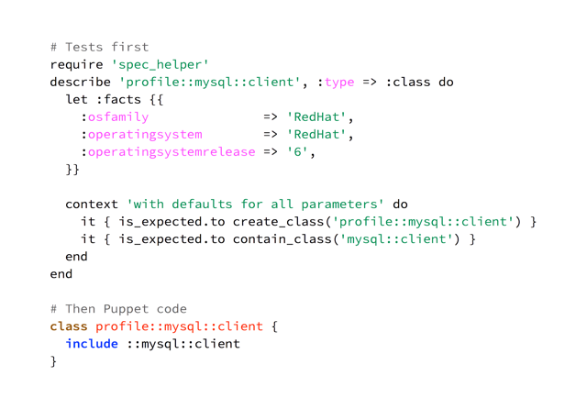
Create Tests, then Code

Slide 24
Testing Summary
“What am I testing and is it valuable?”
Test your code
Let component modules have their own tests
Don’t test Puppet
Notes:
You can download modules and Puppet and run their tests. Puppet Approved modules are required to have passing tests. If the module you chose doesn't have tests or fails the tests, perhaps you should reconsider whether that module should be used in production!

Slide 25
Culture High Points
Pace yourself, avoid culture shock
Create a culture of code review and testing
Use best practices and patterns intelligently

Slide 26
Tooling
Notes:
There are lots of tools in the ecosystem and it can be overwhelming to look at all at once! Some may have no value at all to your organization and can be ignored. Prioritize the remainder and focus on pain points and high value targets first.

Slide 27
Continuous Integration
Travis CI, Jenkins CI, Bamboo
Verify ability to integrate code on every change
Submit a PR, receive red or green feedback. Don’t merge red results!
Continuous, shouldn't be a manual event!

Slide 28
Continuous Deployment
r10k
Never log into your master again!
Controlrepo defines modules via a Puppetfile
Can include site-specific modules and hiera in the controlrepo
Push code upstream, deploy it on the master automatically
Each repo branch becomes a puppet environment
Work with lots of individual repos? Reaktor

Slide 29
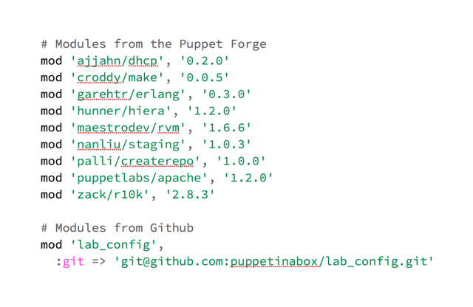
Puppetfile: Pin Versions for Stability
Craft your own Puppetfiles with generate-puppetfile

Slide 30
Separate your Code and Data
Hiera
You can share code - on the forge, with colleagues or support - without sharing your data
Data is particular to your implementation and private, may include passwords
Hierarchal key/value pair lookup tool
Automatic Parameter Lookups performs hiera lookups for every param
ntp::package_manage corresponds to $package_manage in class ntp
Limits with deep merge (HI-118)
Notes:
Felix (@felis_rex), Vanessa, Henrik (@hel) and I are working on a solution for HI-118. You'll need to be on Puppet 4 to benefit from it when it's ready, though!

Slide 31
Bare Metal Provisioning
Razor
Make “rack and stack” the last provisioning step
Discover new hardware, install OS or Hypervisors, add to Puppet and configure
Fully supported with Puppet Enterprise as of version 3.8
You can still use Razor without PE - more assembly required
There are other tools, many of which rely on PXE: opencrowbar, cobbler, xcat
Notes:
Razor is targeted at bare metal, but certainly works with virtual machines as well. It's a great way to test Razor in a controlled environment without affecting production!

Slide 32
Reporting
PuppetDB
Collect reports and exported resources
Agents send reports to PuppetDB
Can be sent from masterless nodes as well
Console or Puppetboard lets you see node status, nodes with fact X, status of all events received for all agents
API is available, craft your own queries
Notes:
You can also view the performance dashboard at http://localhost:8080/pdb/dashboard/index.html

Slide 33
Monitoring
Nagios / Icinga / Sensu / Zabbix
Dynamically populate your monitoring system(s) with exported resources
Export hosts and checks
Infrastructure as Code
Must be able to define checks as a Puppet resource
Export hosts, define checks in the monitoring system
Checks are not defined in the same version control system
May be more flexible when monitoring system includes nodes not managed by Puppet
Notes:
This is just a start! Exported resources can be used in plenty of other situations, such as backups.

Slide 34
Packaging
rpm, deb, pkg, etc.
Maintain and distribute software like a boss
Distribute apps as packages, not tarballs or repos
Definitely NOT with execs!
No .git/.svn directories
Packaging systems capture metadata and work with the OS
Use system packages first, application packages second
Distribute your packages (yumrepo type built-in)
Notes:
Puppet is a good way to distribute packages. It is not a great way to distribute files and then copy them around! Always look at package managers as the first option and execs as the last option - or don’t look at execs at all!

Slide 35
fpm
Packaging isn’t complicated anymore
Thanks Jordan Sissel!
Specify input and output formats
Define dependencies and other metadata (author, contact, etc.)
fpm -s rpm -t deb -d java example.rpm
Install a gem, use fpm to deploy that gem elsewhere
Has a puppet target type, creates a module!
Notes:
Jordan's fpm makes building software fun again!

Slide 36
External Integrations
Make Puppet a part of everything
Provisioning systems: Satellite, Foreman, VMware vRealize Suite
Backups
CMDB and IPAM
Anything that makes your company tick
Notes:
Puppet can provide a lot of value to these systems. Purely coincidental, it also makes Puppet more important to the organization!

Slide 37
Iterate
Deploy now, perfect later
Okay => Good => Better => New Tech => Okay => Good => Better => Repeat
Choose something. Make it work “okay”. Deploy.
Choose something else. Make it work “okay”. Deploy.
Repeat on all processes and tasks.
Repeat it again 6, 12, 18 months later.
Notes:
Getting something out there is always valuable. The earlier you get feedback, the sooner you know whether you're on the right track.

Slide 38
Recap
Culture of change and feedback
Many tools available in the ecosystem
Iterate to success

Slide 39

Notes:
Fly, my pretties!

Slide 40
Reference Links
puppetboard
puppetexplorer
rspec-puppet
puppet-spec
beaker
beaker-rspec
Rise of the Expert Beginner
Recommended pre-commit hook
Beginner’s Guide to Modules
Writing Better Puppet Modules
The problem with params.pp
puppet-retrospec
puppet-module-skeleton
Sh*t Gary Says
r10k project
r10k module
reaktor
Hiera deep merge issue
razor
fpm
Git branch tutorial
https://learn.puppetlabs.com/
http://ask.puppetlabs.com
Puppet Community CI and config
Notes:
If I'm missing anything, let me know and I'll add it!

Slide 41
Thank You!
My awesome wife, Michelle!
Puppet Labs
Puppet Community
Reviewers
Jason Breitwieser
Ryan McKern (@the_mckern)
Richard Pijnenburg (electrical / @richardp82)
Walid Shaari
Tim Meusel (bastelfreak)

Slide 42
Q&A

